Slide 1
Development of Game Changing Technology through Collaborative Innovation
Notes:
1

Slide 2
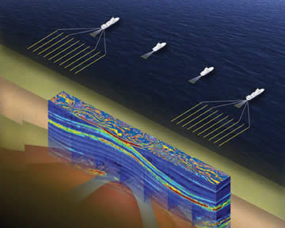
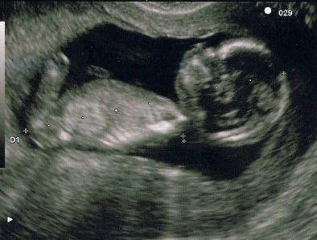
Seismic: Mother Earth’s Sonogram

Slide 3
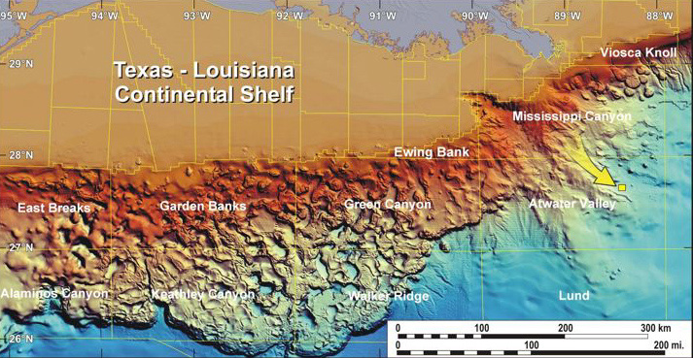
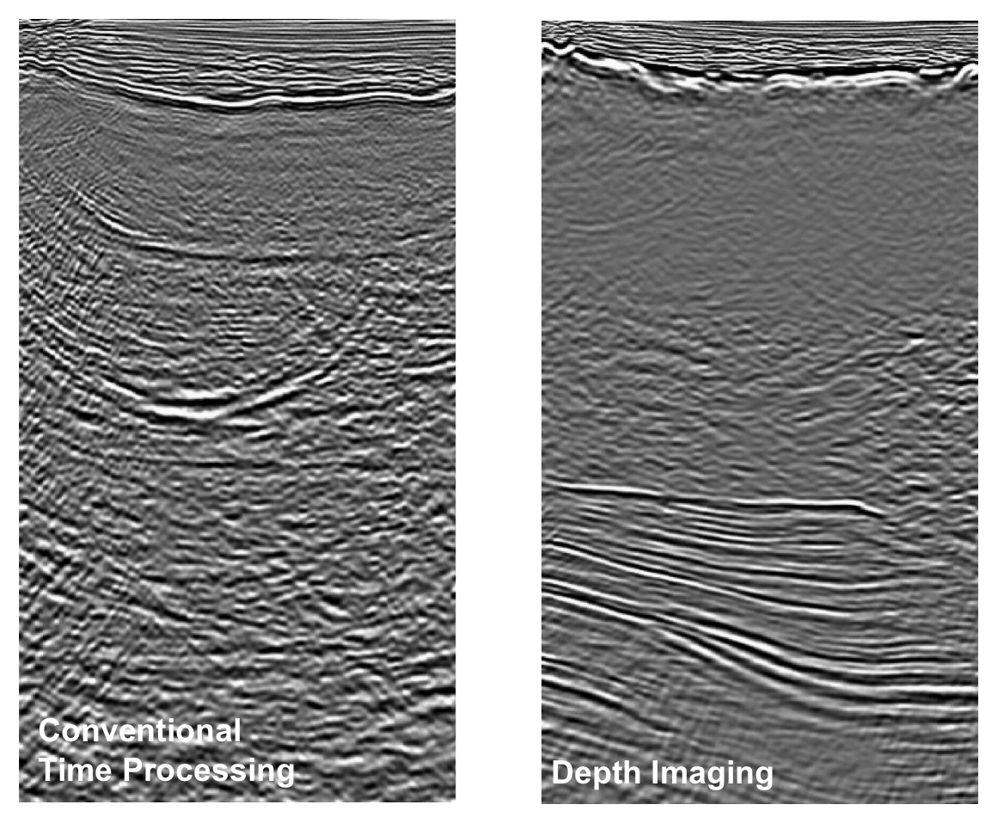
Deep Water Subsalt Imaging
Source oceanexplorer.noaa.gov

Slide 4
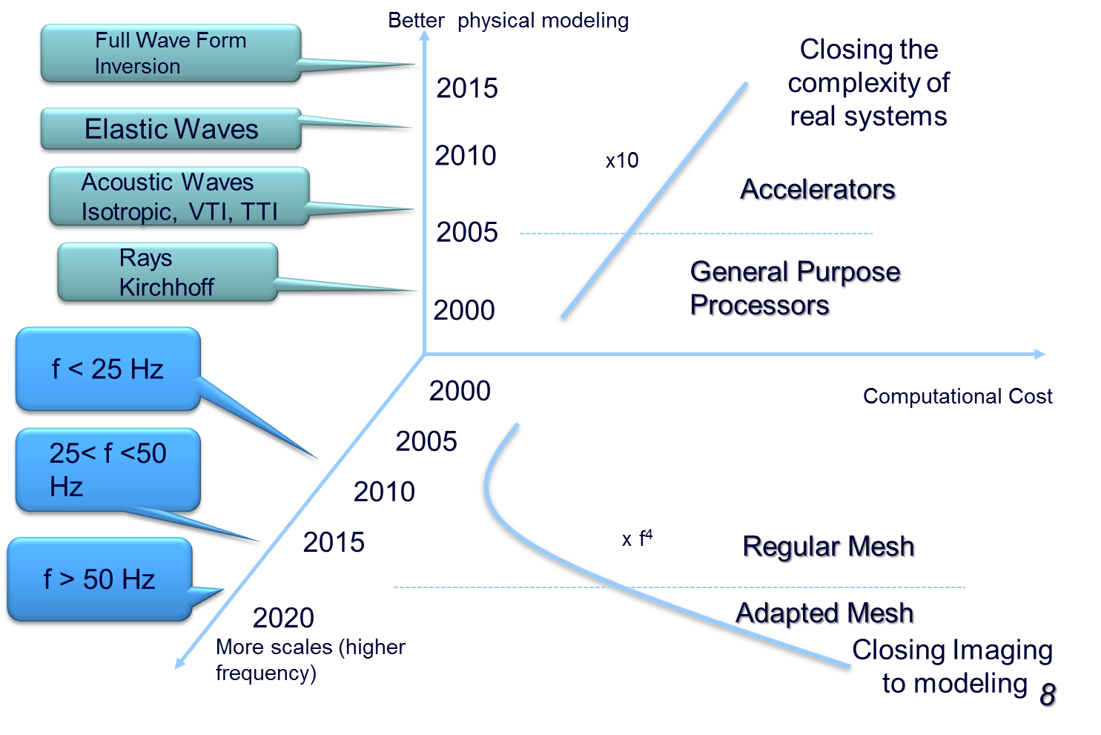
Two reasons for HPC

Slide 5
Drivers of Innovation

Slide 6
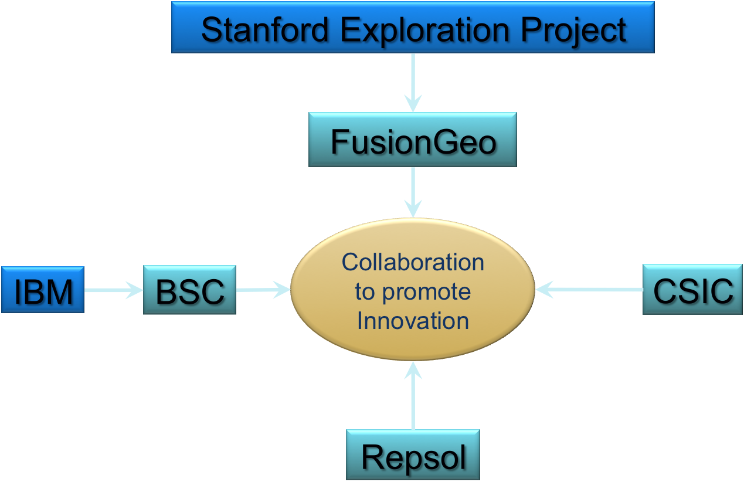
The Kaleidoscope Project

Slide 7
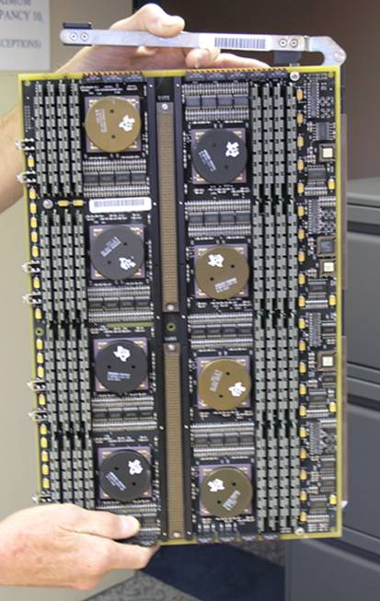
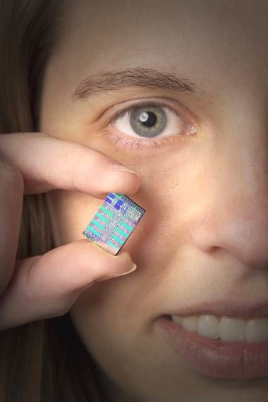
The PlayStation 3 Processor
1994
1 GFlops
2007
200 GFlops
Courtesy IBM

Slide 9
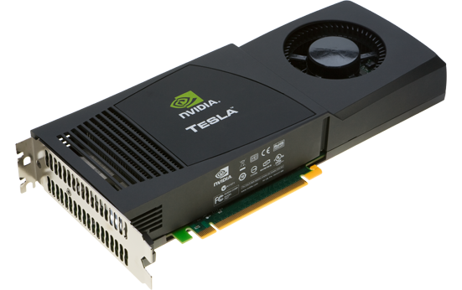
The GPU Accelerator
2007
200 GFlops
2012
3000 GFlops
Courtesy IBM

Slide 10
Changing Landscape of Commodity Hardware
2005
2010
2015
2020
PlayStation (Cell BE)
Video Accelerator (GPU Nvidia)
Future Technologies ?

Slide 11
Awards in recognition of Repsol’s Approach
IEEE Winner 2008
2009 Platt’s Awards
Computerworld
Finalist 2008 EE Times ACE Awards
Finalist 2008 Awards Petroleum Economist

Slide 12
Social Responsibility

