Slide 1
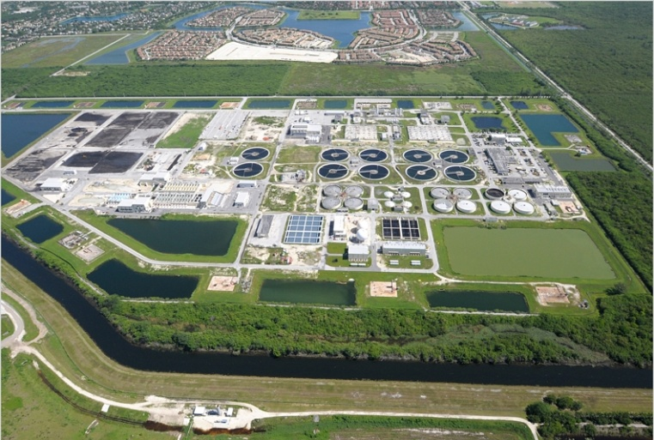
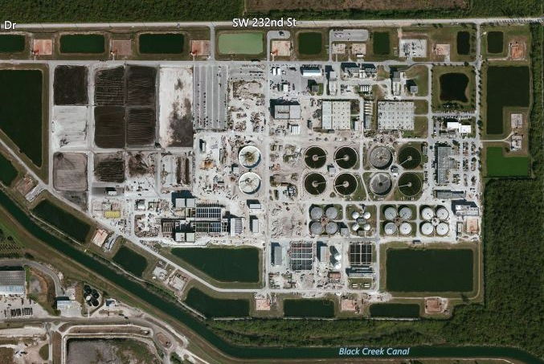
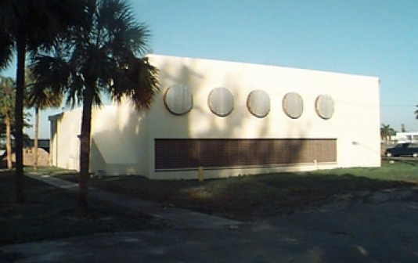
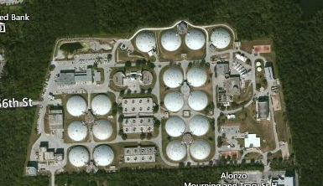
Miami-Dade Water and Sewer Department
Multi-Year Capital Improvement Plan
Presentation for the II Forum - USA European Union - May 15, 2014

Slide 2
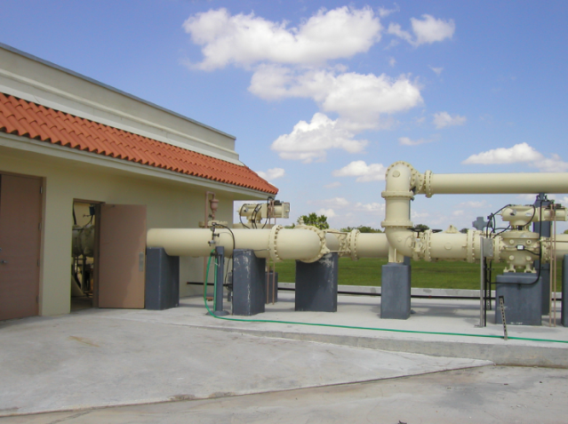
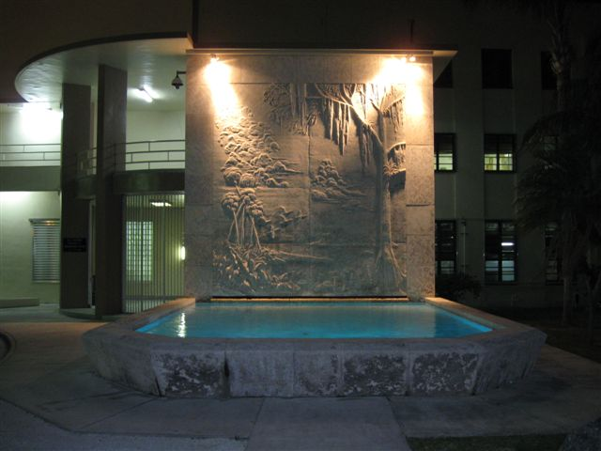
Existing Water Infrastructure
3 large regional and 5 small water treatment plants
100 water supply wells
7,918 miles of pipes
38,000 fire hydrants
126,000 valves
11 treated water storage tanks
455,000 water meters

Slide 3
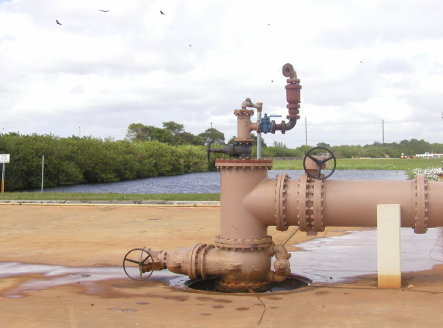
Existing Wastewater Infrastructure
3 wastewater treatment plants
2 ocean outfalls
21 deep injection wells
6,277 miles of pipes
1,042 sewer pumps stations

Slide 4
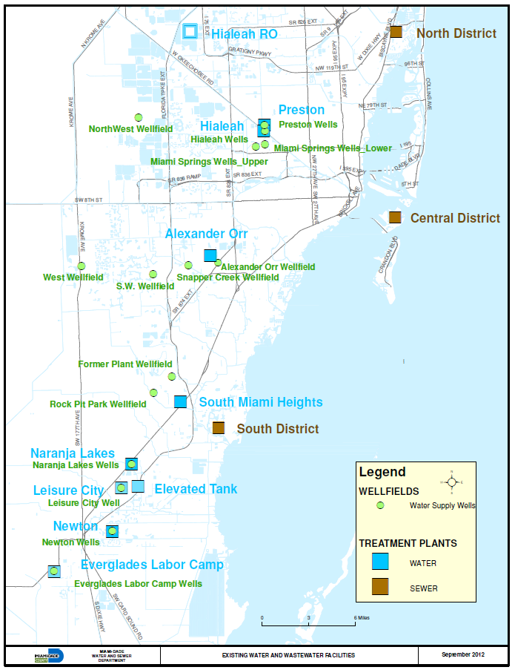
WASD’s Water & Wastewater
Major
Facilities

Slide 5
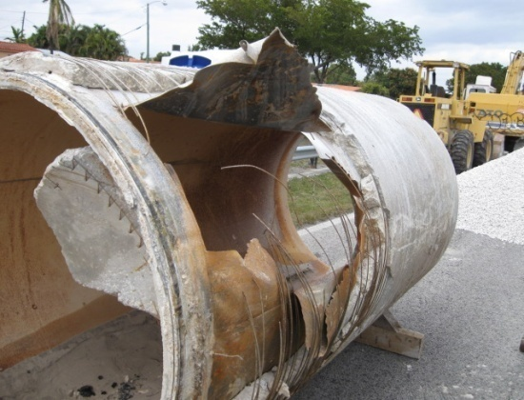
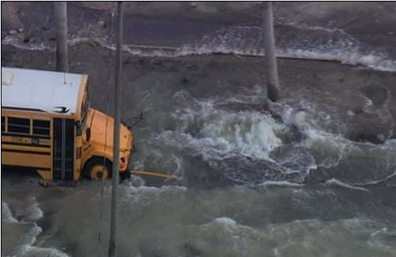
Infrastructure Deficiencies
February 2012, R-170-12, directed Mayor to provide report addressing WASD’s most critical infrastructure renewal needs
July 2012, report transmitted to the Board
Report identified:
  Critical water and sewer projects
  $1.1 billion estimated cost to implement
    $364.2 million Water
    $736.1 million Wastewater
  Total funding needs ($12.6B)

Slide 6
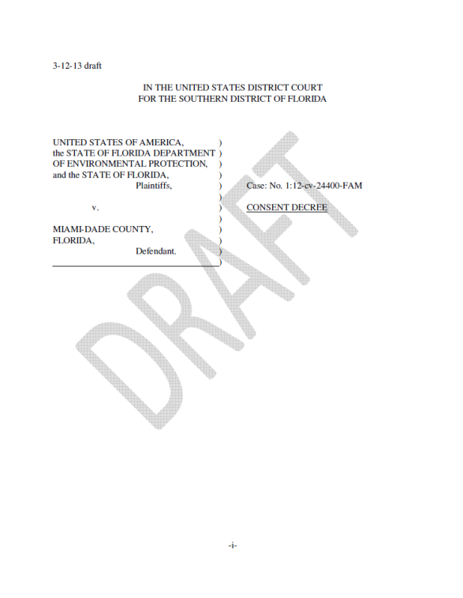
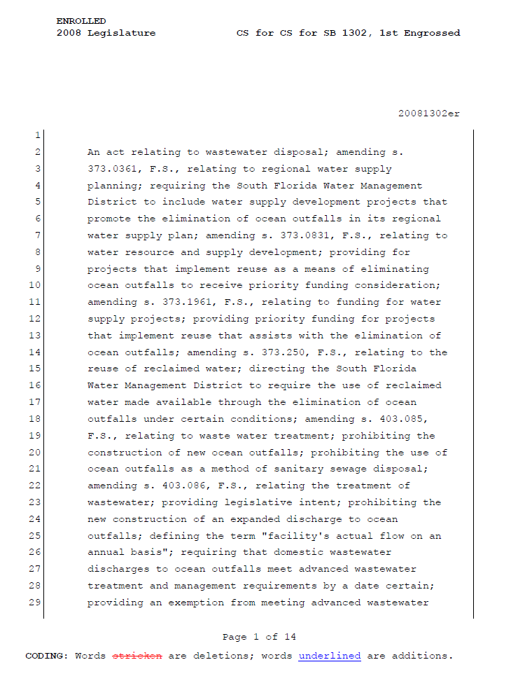
Current Regulatory Challenges
Compliance with the Federal Clean Water Act (EPA Consent Decree)
Compliance with the State 2008 Ocean Outfall Legislation
Continued compliance with Safe Drinking Water Act Requirements
Renewing undersized water mains for fire flow and water quality requirements
Consent Decree approved by the Federal Court on April 11,2014.

Slide 7
State Ocean Outfall Legislation
Bill passed in the 2008 Session
Requires:
  July 1, 2013, submit implementation plan to FDEP
  Reduce nutrients out to the ocean
  December 31, 2025, stop using outfall and implement 60% reuse
Currently supporting a bill that will amend these requirements to reduce implementation costs

Slide 8
Other Needs
Other Regulatory Related: These are capital projects that are required by various regulatory requirements such as Outfall Legislation, Safe Drinking Water Act, Health and Safety Regulations, etc. Failure to do these projects will result in violations of law subject to fines and other enforcement actions.
Growth & Development Related: These are capital projects that address capacity limitations and other deficiencies in the system which restrict and/or limit construction projects and other developments.
Rehabilitation and Replacement Related: These are capital projects that address identified rehabilitation and replacement infrastructure needs. Failure to perform these projects could result in pipe failures and equipment breakdowns with attendant service interruptions, sewage spills and other permit violations subject to regulatory enforcement actions and fines.

Slide 9
Miami-Dade County Water & Sewer Department
Prior FY12-13 FY13-14 FY14-15 FY16-17 FY17-18 FY18-19 FY20-27
Proposed Multi-Year Capital Improvement Plan is $12.6Billion
  Water is $4.08Billion
  Wastewater is 8.56Billion

Slide 10
Consent Decree Projected Expenditures timeline
Consent Decree Related: These are wastewater capital projects that are included in the Consent Decree. Failure to do these projects within the prescribed schedule will result in violations of the terms and conditions of the Consent Decree subject to stipulated penalties.
Project Name | Prior | FY13 - 19 Expenditures | FY 20- 27 Expenditures | Project Total
Wastewater Treatment Plants | $7,126,868 | $419,861,462 | $599,778,803 | $1,026,767,133
Wastewater Pipes | $37,262,499 | $353,705,256 | $79,173,913 | $470,141,668
Sewer Pump Stations | $1,005,978 | $105,762,443 | $0 | $106,768,421
Totals | $45,395,345 | $879,329,161 | $678,952,716 | $1,603,677,222

Slide 11
Total Multi-Year Capital Improvement Plan
Project Categories | Prior | FY13-19 Projected Expenditures | FY20-27 Projected Expenditures | Total
Water
Plants | $76,089,575 | $915,392,370 | $626,305,799 | $1,617,787,744
Pipelines | $98,073,090 | $558,733,216 | $1,602,148,654 | $2,258,954,960
Other | $17,968,077 | $93,140,625 | $87,329,350 | $198,438,052
Total | $192,130,741 | $1,567,266,211 | $2,315,783,803 | $4,075,180,755
Wastewater
Plants | $161,994,872 | $1,104,364,497 | $3,781,910,738 | $5,048,270,107
Pipelines | $105,842,002 | $1,053,314,491 | $977,998,774 | $2,137,155,267
Pump Stations | $24,208,487 | $793,872,137 | $293,946,970 | $1,112,027,594
Other | $5,884,403 | $118,016,032 | $138,687,484 | $262,587,919
Total | $297,929,765 | $3,069,567,157 | $5,192,543,966 | $8,560,040,888
Combined Total | $490,060,506 | $4,636,833,368 | $7,508,327,769 | $12,635,221,643

Slide 12
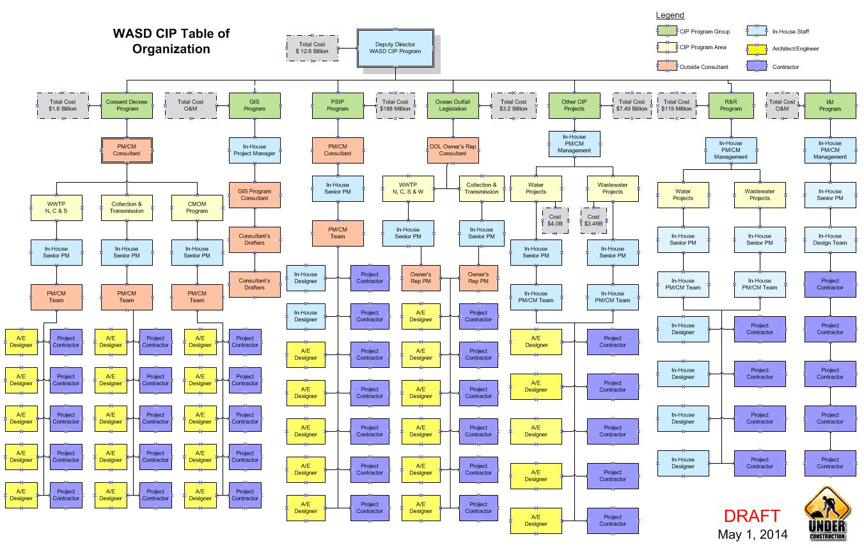

Slide 13


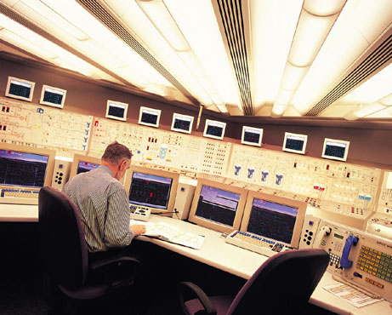

Differentiating Delivery Methods
Traditional
DBB
Design
Construction
Operations
DBO
DBOF
DBOOF
Design
Operations
Construction

Slide 14
WASD Initiatives
Alternative Project Delivery (APD) Methods
P3 Alternative Project Delivery (APD) Methods
Design Build
Progressive Design Build
IPD method
MGC
CMNAR
CMAR
Owner’s Representative
Design Build Operate (DBO)
Design Build Operate & Maintain (DBOM)
Design Build Finance Operate & Maintain (DBFOM)
We are NOT contemplating any form of ownership transfers.

Slide 15
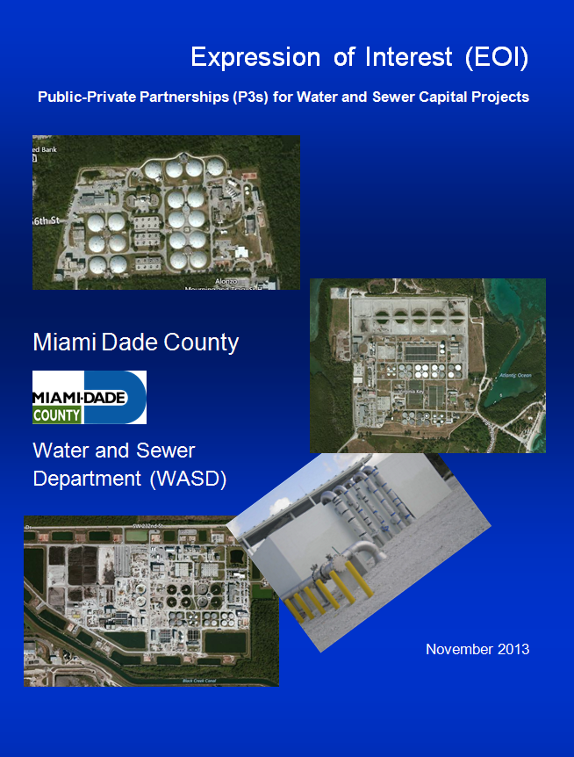
Expression Of Interest
32 Respondents
Areas of Interest:
  WWTP
  WTP
  PS
  Bio-solids
  AMR
  Energy Optimization
Type of delivery proposed: DBFOM, DBOM, DBO, PDBO, etc.

Slide 16
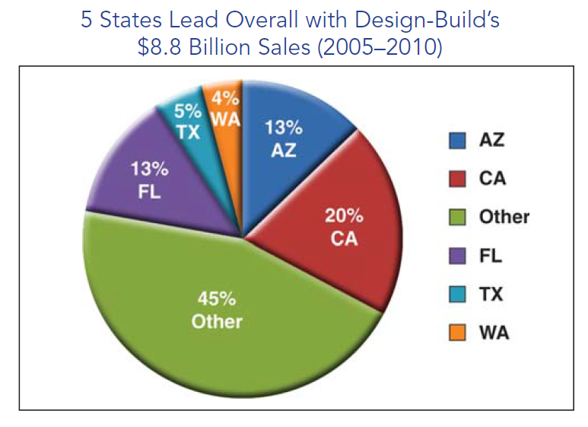
APD by States (W/WW)

Slide 17
Participants Under Design-Bid-Build
Policy Makers/ Stakeholders
Design
Engineer
Policy
Design Fee
Fully Detailed
Design
DSDC
Construction Inspection
Utility
Operator
Utility
Low Bid
Construction Fee
Service
Responsive to Policies
Project
Construction
Constructor
Utility
Customer
Charges
Customers
*DSDC: Design Services During Construction

Slide 18
Participants Under CM-at-Risk
Policy Makers/ Stakeholders
Design
Engineer
Policy
Fee
Fully Detailed
Design
Owner’s
Agent
Fee
DSDC
Construction Inspection
Utility
Procurement
Services
Input During
Design
Project
Construction
CM-at-Risk
Fee up to GMP*
$ Guarantee
Responsive to Policies
Utility Service
Customer
Charges
Utility
Operator
Customers
Subcontractors
(CM subs most or all construction)
*GMP: Guaranteed Maximum Price

Slide 19
Participants Under Design-Build
Policy Makers/ Stakeholders
Guarantor*
Guaranty Agreement
Policy
Fee
Design/Build
Fee
Owner’s
Agent
Utility
DB Contractor
Procurement
Services/
Contract
Oversight
Design &
Construction
DSDC
Construction Inspection
Responsive to Policies
Utility Service
Customer
Utility
Operator
Charges
Customers
* Guarantor may not be required if DB Contractor has adequate financial strength.

Slide 20
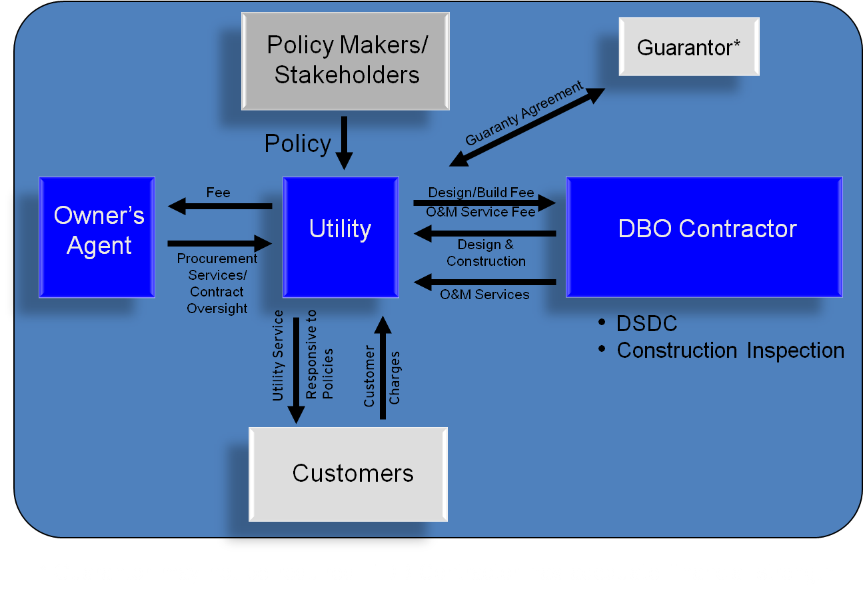
Participants Under Design-Build-Operate

Slide 21
Classic International P3 Arrangement
Key Considerations
Public Sector Sponsor
Maintain Public Control
Public sector holds ultimate ownership of asset, regardless if it is newly constructed or existing prior to lease
P3
Agreement
User Fee Payments
Interest or
Returns
Project Developer
Deliver Much-Needed Assets
Public sponsors can leverage APD to deliver assets in a tight budget environment
Financier(s)
The Public
Financial
Investment
Drive Value Creation
APD projects must provide public value creation and satisfy numerous project, government, and general public requirements
Milestone
Payments
Construction
Contracts
Contractor(s)

Slide 22
Major Advantages
DBO | DBOF | DBOOF
Public (tax-exempt) financing is lowest cost of borrowing County has substantial control of the entire process, which includes site selection, permitting, technology selection, and related issues County owns facility and pays construction costs via milestone payments, thus termination is easier No take or pay commitment required | County has some involvement in development if ownership is retained County does not make payments until facility is constructed and operational Development, design, construction, and operation risks generally transferred to Contractor Debt service payments are Contractor’s responsibility Off balance sheet financing approach | County does not make payments until facility is constructed and operational Full development, design, construction, and operations risk transferred to Developer Debt service payments are Developer’s responsibility Off balance sheet financing approach

Slide 23
Major Disadvantages
DBO | DBOF | DBOOF
County required to issue bonds and pay for development at project outset Debt service remains on County’s books Payment to Contractor must generally be a fixed fee for O&M services (i.e., usage fee for majority of O&M services not allowed under IRS regulations) | Private financing is much more expensive than public financing Take or pay commitment required by the County for water purchase County has little involvement in development especially if ownership is private | Private financing is much more expensive than public financing Take or pay commitment required by the County for water purchase County has no involvement in development since it is a completely private facility Limited County options at the end of the contract term

Slide 24

Issues before Proceeding with Private Sector Development
Policy Issues
Need for the project and financial viability
Selection of delivery method
Overall goals of Owner
Implementation strategy
Commitment required before proceeding
Process Issues
Owner procurement process
Water quantity and quality requirements
Interrelationship with rate structure
Development schedule
Market outreach

Slide 25
Thoughtful Procurement Process Critical for Project Success
Receive
SOQs
Owner Specific Policies and Procedures
Issue
RFQ
Short-list
Respondents
Issue RFP
w/
Contract
Receive Technical & Price Proposals
Clarification Requests and Meetings w/
Proposers (Optional)
Evaluate Proposals
and Select Successful Proposer
Incorporate Selected
Proposal Information
into Contract
Owner Approval
Finalize Contract w/Successful Proposer
Execute
Contract
Notes:
Raul – This is how we will set the framework for based on proven experience
What we understand is overall sequence of activities – at end (2nd set boxes) Proposal becomes a document it is diff. than an non-db approach in that ?? Standard steps bring to earth

Slide 27
Conclusions
To renew the system, fulfill regulatory obligations, and support economic development, significant investment is required in the coming years ($12.6 billion)
Investment is necessary in both, facilities and operations.
All Project deliveries alternatives are being fully explored and evaluated.
Good news is that even with the needed investment, rates will remain very competitive when compared with other utilities.

Slide 28
Questions?
JC Arteaga, AIA, NCARB, APA, CGC, CBO, LEED®AP
Deputy Director
Water & Sewer Department
3071 SW 38 Avenue, Miami, FL 33146
Off 786-552-8571
Cell 305-218-8976
Email: jcarteaga@miamidade.gov
Website: www.miamidade.gov/water

