Slide 1
ICT4D

Slide 2
let me tell you a story

Slide 3
WSIS 2005, Tunis
Digital Divide

Slide 4






Slide 5
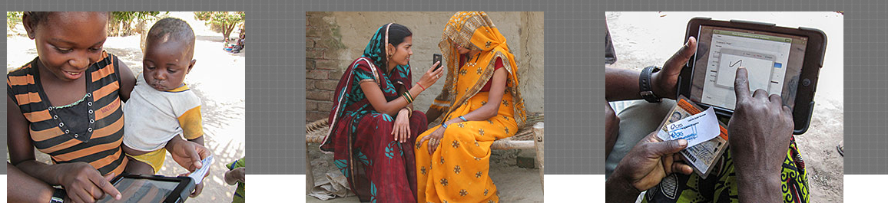
available computing power:
CLOUD
Very Fast Networks: 4G/LTE
democratization of the access device
Easy to access marketplaces: Apps

Slide 6
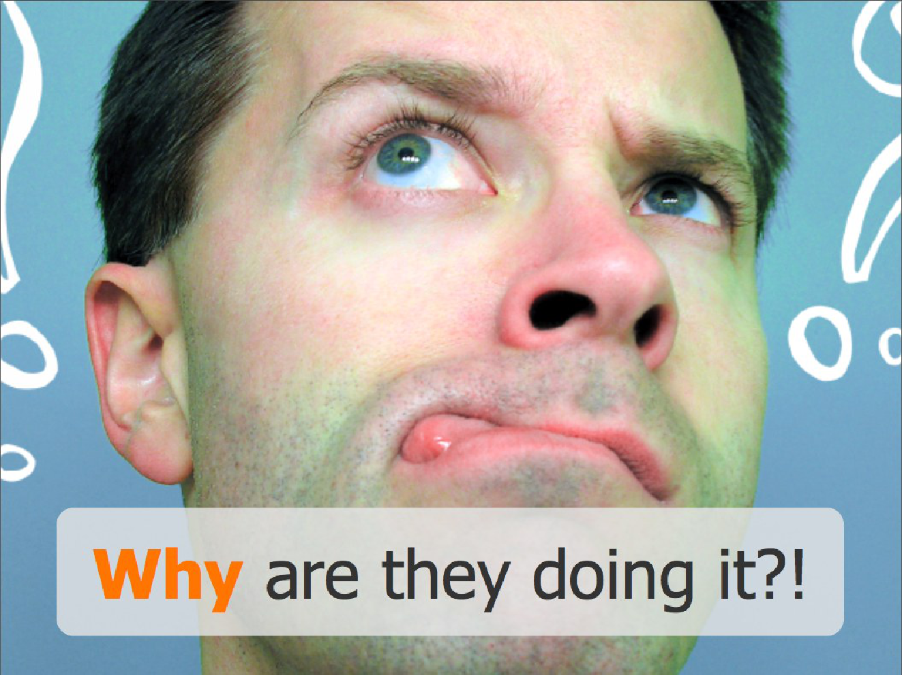
And how that affects new markets in emerging economies?

Slide 7
#> build_my_app [args...]

Slide 8
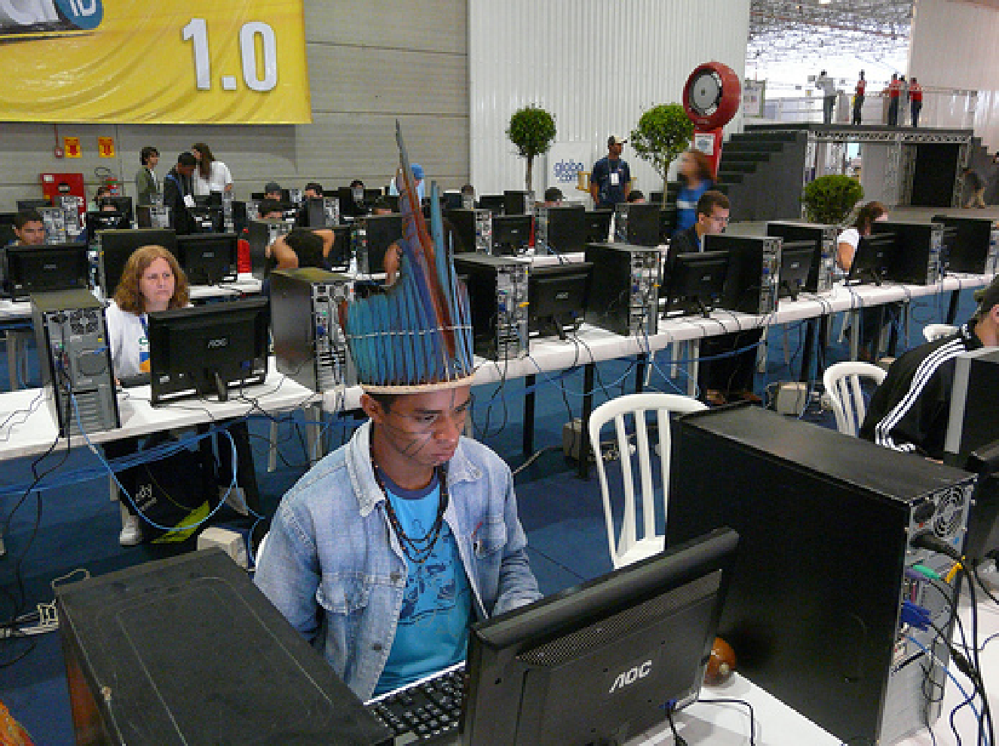
Brazilian indian of the Potyguara nation using a mobile telecentre
infrastructure in São Paulo, Brazil. They are available at different cities in the Amazon rain forest, but there is the need to at least double their number.

Slide 9


Slide 10
Dong Nguyen grew up in Van Phuc, a village outside Hanoi.
He discovered video as a child, and began coding his own at age 16. At 19, while studying programming at a local university, he won an internship at Punch Entertainment, one of very few video game companies in Vietnam.
On discovering the iPhone, he found that its most popular games such as Angry Birds were too complicated, and desired making a simpler game for people who are "always on the move".
Flappy Bird was created and developed in the span of 2 to 3 days. Flappy Bird was earning $50,000 a day from in-app advertisements.

Slide 11
technology overtook policy

Slide 12
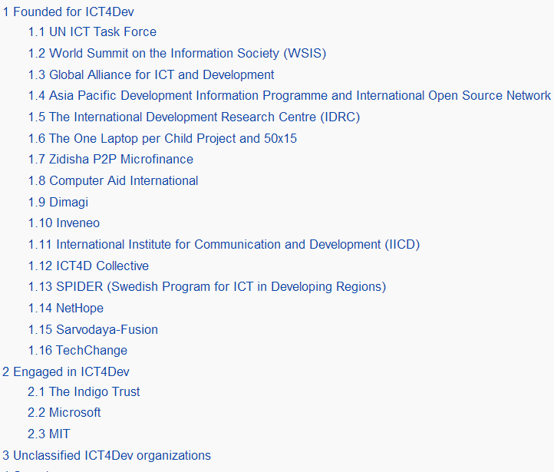


Slide 13


Thank You

