Slide 1







Citizen Services
Servicios Ciudadanos
II United States – European Union Forum
Mr. Eduardo Gonzalez
FCC Aqualia Chairman
Miami – May 2014
Notes:
1

Slide 2
Disclaimer
Citizen Services
This document may contain forward-looking statements regarding intentions, expectations or predictions by the FCC Group and its management as of the date of writing in connection with various aspects such as the growth of the business lines, FCC Group earnings, and other aspects related to its activity and situation.
By their nature, such forward-looking statements do not constitute guarantees of future performance and are affected by risks, uncertainties and other material aspects that could lead developments and final outcomes to differ materially from those expressed in these statements.
This document does not constitute an offering or an invitation to acquire or subscribe shares in accordance with Act 24/1988, of 28 July, on the Securities Market, Royal Decree-Act 5/2005, of 11 March, and/or Royal Decree 1310/2005, of 4 November, and their implementing regulations.
Additionally, this document is neither an offer to buy nor a solicitation to purchase, sell or exchange shares, nor is it a request for any kind of vote or approval in any other jurisdiction.
The contents of this statement should be taken into account by any person or entity that has to make decisions or prepare or distribute opinions about securities issued by FCC Group. They are all encouraged to consult FCC Group's public documentation filed with the Spanish National Securities Market Commission.
Notes:
2

Slide 3

1
Citizen Services
FCC Group
1.1 Environmental Services, Water & Infrastructure
1.2 Leading position
1.3 Diversified business model
1.4 A global PPP leader
1.5 Strategic Plan Initiatives
3
Notes:
3

Slide 4

FCC Group
Citizen Services
Leading Group in Environmental Services, Water and Infrastructure development
€ 6.7 Bn revenues and € 720 Mn EBITDA in 2013
Over 55.000 employees
Diversified business model
Operating in over 20 countries / 42% of revenues come from international markets
High income visibility
Permanent presence in the Florida since 2008
Notes:
4

Slide 5






Leading position
Citizen Services
Leading Group in Environmental Services, Water and Infrastructure…
1st in waste disposal in the UK
1st in environmental services and
infrastructure construction in Spain
3rd in water management in Czech Republic
1st in waste management in Austria and Eastern Europe
2nd in water management in Spain and 4th in the world
2nd cement producer in Spain
… operating in over 20 countries
Notes:
5

Slide 6
Diversified business model
Citizen Services
2013 EBITDA by Business Area
2013 Revenues by Geographic Area
Environmental Services 55%
International 42%
Infrastructure Development 20%
Water 25%
Spain 58%
80% of the EBITDA comes from recurrent activities with high visibility such as Environmental Services and Water
42% of revenues come from international markets, where FCC is a leading Group in Environmental Services and Infrastructure development
Notes:
6

Slide 7

A global PPP leader
Services for Citizens
Leader in PPP development worldwide, including +400 water concessions and 45 Transportation concessions in 20 countries
Spain
5 Tramways
5 Subways
16 Highways
1 Tunnel
3 Hospitals and 10 Health Centers
4 Social Facilities
2 Ports and 2 Marinas
1 Airport
+400 water concessions and BOT assets
707 MW renewable energy assets (wind, PV solar, SCP solar, EFW)
United Kingdom
1 Hospital
Canada
1 Highway
Ireland
2 Highways
Austria
1 Highway
Mexico
1 Highway
1 Tunnel
2 water BOT
Croatia
1 Highway
Andorra
1 Tunnel
Russia
1 Highway
Costa Rica
2 Highways
Portugal
2 Highways
China
1 Highway
Ecuador
1 water BOT
1 water concession
Morocco
1 water BOT
Colombia
1 water BOT
1 water concession
Algeria
1 water BOT
Egypt
1 water BOT
Peru
1 water BOT
1 waste management
Chile
2 Highways
1 Airport
1 water BOT
Tunisia
1 water BOT
7

Slide 8
Strategic Plan initiatives
Citizen Services
On March 2013 FCC launched its current Strategic Plan focusing on its core businesses to increase their cash generation capacity, reduce debt and align it with cash generation through several initiatives:
Asset divestments
Implementing a € 2.2 Bn non-strategic asset divestment program – 70% executed
Efficiency Program
Overhead cost reduction in all areas, at both corporate and operational levels – To be concluded in 2014
Refinancing Plan
Long term and comprehensive financing solution, aligned with strategic objectives - Concluded
Reinforcing leadership in Environmental Services and Water
Strengthening leadership in Spanish Environmental Services and ASA (waste management in Central Europe)
Repositioning of UK business to waste management and treatment activities
Reinforcement of Water leadership in Spain and fostering organic international growth
Infrastructure business focusing
Profitability boost in International Construction, focusing activity in selective projects and geographies
Development of a comprehensive optimization program in U.S. Cement operations

Slide 9
2
Citizen Services
Business Areas
2.1 Environmental Services
2.2 Water
2.3 Construction
2.4 Cement
9
Notes:
9

Slide 10

Environmental Services
Citizen Services
2013 Revenues by Business Segment
2013 Revenues by Geographic Area
Spain: 57%
U.K: 29%
Urban Waste Mgmt: 95%
1st in Spain, U.K. & Austria
Industrial Waste: 5%
1st in Spain and Portugal
Austria & Eastern Europe: 12%
Others : 2%
Strengthening the position of Environmental Services in Spain, repositioning the UK business
Spanish Environmental Services
Strengthening of leadership position
International Environmental Services
Repositioning Business in UK
Reinforcement of leadership by increasing contracts
Improvements in efficiency by controlling costs and limiting to maintenance investments
Boosting of the activity of waste treatment and management services in the UK
Adjustment of landfill portfolio to current demand

Slide 11
Environmental Services
Citizen Services
Revenue performance¹ 2009 – 2013
Backlog at 31 Dec. 2013
CAGR
+ 0.4%
11,884 €Mn
2,804 €Mn
2,890 €Mn
2,827 €Mn
2,770 €Mn
2,730 €Mn
2009
2010
2011
2012
2013
4.3 x Annual Revenues
63% Spain
37% International
Revenues adjusted by US Industrial Waste business deconsolidation.
Notes:
11
…

Slide 12

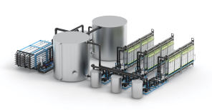
Water
Citizen Services
2013 Revenues by Business Segment
2013 Revenues by Geographic Area
Spain: 80%
Eastern Europe: 10%
Water Mgmt & distribution: 92%
2nd in Spain, 3rd in Czech Republic, and 4th worldwide
Italy &
Portugal: 10%
Water Infrastructure: 8%
Other: 12%
Reinforcement of FCC Water’s leadership and its international expansion
Spanish Water
Reinforcing strong market position
International Water
Fostering selective growth
Increase current 30% Spanish market share
Improvements based on tariffs, increase of existing services coverage and rising public outsourcing
International expansion through EPC models and the use of proprietary technology in the water cycle management
Increase of profitability in water infrastructure development

Slide 13
Water
Citizen Services
Revenue performance 2009 - 2013
Backlog at 31 Dec. 2013
CAGR
+ 1.6%
14,373 €Mn
872 €Mn
868 €Mn
901 €Mn
930 €Mn
845 €Mn
2009
2010
2011
2012
2013
15.5 x Annual Revenues
71% Spain
29% International
Notes:
13
…

Slide 14
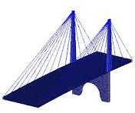
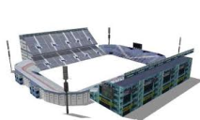
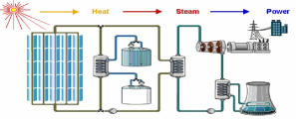
Construction
Citizen Services
2013 Revenues by Business Segment
2013 Revenues by Geographic Area
Spain: 56%
Latin America: 34%
Civil works: 60%
Building: 27%
Industrial: 13%
Others : 4%
Europe: 6%
Spanish Construction capacity adjustment and bolstering International Construction in selective and high growth potential geographies
Spanish Construction
Capacity adjustment to market situation
International Construction
Profitability boost based on specific geographies
Personnel reduction in progress to adapt to current market conditions
Downscaling commercial structure, adapting it to the current market situation
Selective projects and market activity: specific geographies in Latin America and MENA, and selected projects in the USA
Industrial business growth in certain Latin American geographies

Slide 15

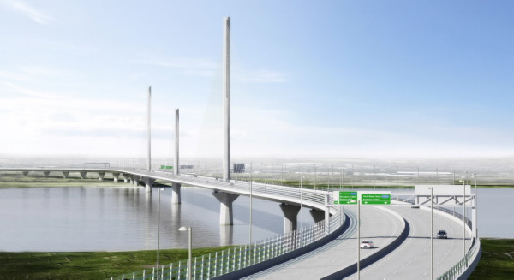
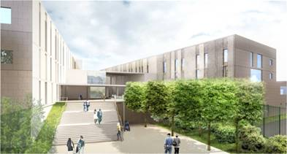
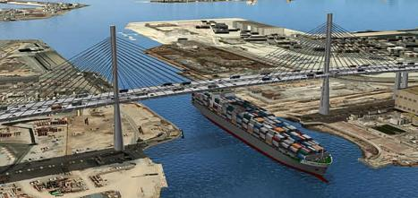
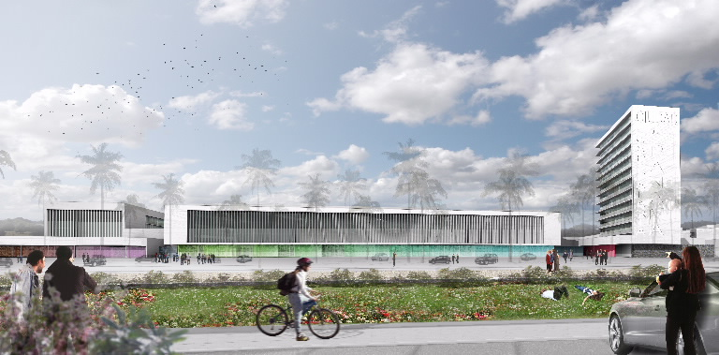
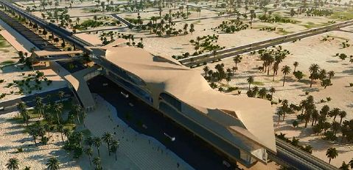
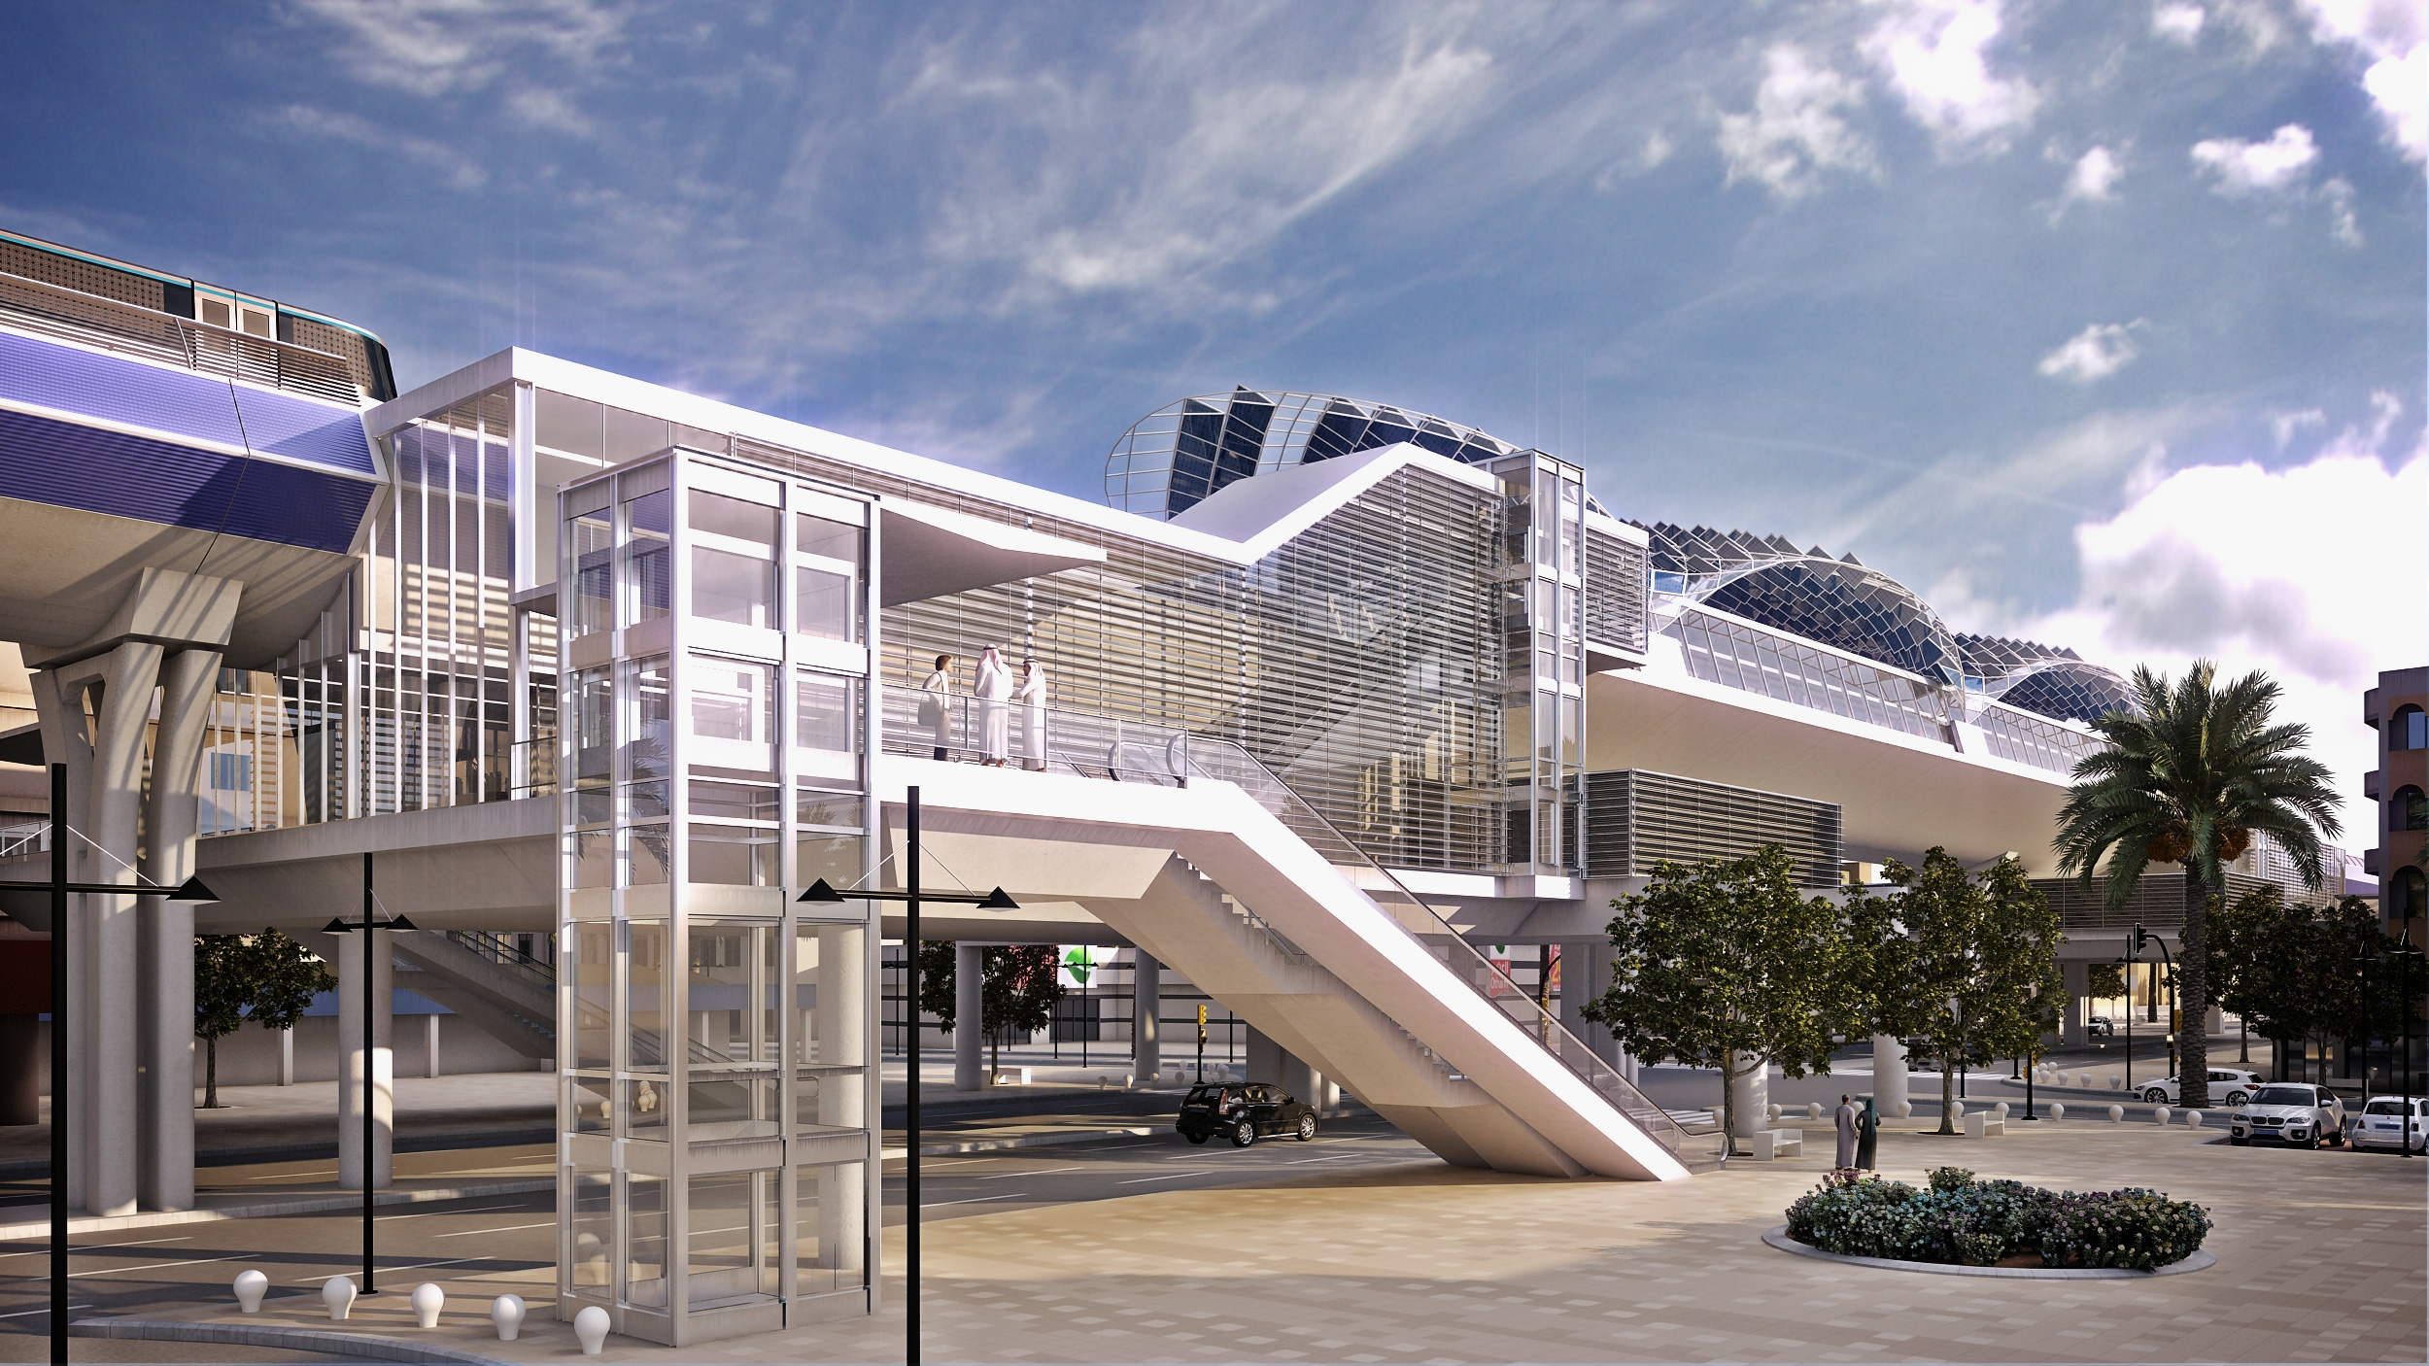
Construction
Citizen Services
Recent contracts in international markets
Mersey Bridge
Gerald Desmond bridge
Los Ángeles
Haren Prison
Hospital City
Panama
Riyadh Metro
Doha Metro
Lima Metro
Construction backlog of 6,608 €Mn¹ covers 2.6 times annual revenues (38% Spain, 62% International)
Over 1 €Bn of recent new international contracts still to be included
As of December 2013.
Notes:
15
…

Slide 16
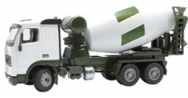
Cement
Citizen Services
2013 Revenues by Business Segment
2013 Revenues by Geographic Area
Spain: 40%
United States: 33%
Cement: 79%
2nd in Spain and Tunisia, 3rd in US East Coast
Concrete & other: 21%
UK & other: 11%
Tunis: 16%
CPV is implementing an adjustment in its means of production, along with the development of drivers to increase efficiency in both Spain and the U.S.
Spanish Cement
Adjustment of structure and efficiency improvement
International Cement
Development of comprehensive optimization program
Adjustment of personnel and structure including periodic closure of industrial plants
Closure of less profitable business lines:
Wage flexibilization
Variable cost reduction
Increased plant utilization
Optimization procurement
Cancellation of expendable external contracts

Slide 17
3
Citizen Services
Why FCC?
17
Notes:
17

Slide 18

why FCC?
Services for Citizens
Rational
Description
Growing demand of complex projects in the region
There´s an important need of Infrastructure investments in the region to improve competitivity and due to social needs in the area, requiring bigger projects and more complex requiring an adequate funding for the project. There is a need of international players with experience in how to deliver those projects and how to finance rationally the projects.
FCC has a deep experience in projects with risk share mechanism with Governments with a PPP approach (turnkey, DBOM, DBF or PPP)
FCC is global leader in infrastructures, environmental services and water
Due to the needs in Infrastructure and the need to enhance the Services in the region , FCC is an ideal partner both for Governments and Lenders as a result of its experience to develop this projects in all matters
Project Financing Experience
Local and international markets with growing appetite in the region with longer tenors. The experience in innovative financings is key
Excellent relationship with funds which will be key in the process
Growing demand of pension funds and the WIFIA financing component enhance the appetite in the market for bigger projects.
Deep capabilities in managing contractual issues and conflicts
An adequate regulation in PPP reinforce the participation of the private sector. FCC can help in the procurement process of a PPP due to its experience, improving the equilibrium of the transfer of risks to the private sector
The speed in conflicts resolution is a key factor in the success of the project (right of way, permits) and where the experience in PPP is a differentiation element.
Unique technical capabilities
Unique technical capabilities and knowledge of FCC in complex projects: water (3rd worldwide), rail (high speed rail, metros and light rails), toll roads (tunnels and bridges), environmental services and renewable energy
Good track record with no significant extra costs or delays in projects.
Local presence in the America´s region, starting around 40 years ago in Venezuela and with permanent presence across the region in the last 20 years with over 5,000 local employees with self performance capabilities and good relations with Governments, partners, suppliers, local banks and local players
18
Notes:
18
18

Slide 19
Lessons of experience in PPPs
Services for Citizens
A good equilibrium in the transfer of risks and rewards between the private and public sectors is the key element (deal break)
The support of capital markets, ECAs and surety providers is crucial in big projects
Partial payments during construction reduce the financial cost, limiting the projects to be procured by the Government due to debt limits. A good structuring will allocate the cash flow generation of the project to the debt to be supported by the private sector
For the security of the project, Lenders and Sponsors will avoid demand risk, having a preference in the payment per availability method vs demand risk.
$
DEMAND RISK
PARTIAL PAYMENTS DURING CONSTRUCTION
BID PHASE
t
DESIGN STAGE
OPERATION AND MAINTENANCE
EQUITY RETURN
MANTAINANCE CAPEX
A balloon payment in the case of an availability payment mechanism covering the gap of traffic risk is not attractive to the Sponsors (leverage)
CAPEX CONSTRUCCION
A good allocation of risks and an adequate structure secures that construction price and technical capabilities are the criteria for the award without paying an extra cost due to debt structuring, excess of equity or inadequate transfer of risk to the sponsors.
19

Slide 20
Some of our experiences
Services for Citizens
PROJECT | DESCRIPTION | STATUS | TENOR | CAPEX | CONSORTIUM | MAIN MILESTONES
CONCESSION SAN JOSÉ CALDERA (COSTA RICA) | Concession of a Toll Road San José – Caldera with minimum secured revenues | Operational | 25 years | $ 215 M | FCC SACYR SOARES | First PPP in Costa Rica Involvement of MIGA for the wrap up of the payment risk of Costa Rica and to enhance tenor Success of Minimum availability payments secured every year opposed to traffic risk
LINE 1 PANAMA METRO (PANAMA) | Line 1 of Panama City (8 Kms tunnel and 14 Kms in total with 11 stations) | Under execution (+80% completed) | DBF (no O&M) | $ 2,000 M | FCC Odebrecht | First Metro project in Panama Great success of the Securitization Model with CNO (1,200 M$ in total) mixed with ECA financing for the government for the rolling stock.
NEW CAIRO WASTE WATER TREATEMENT PLANT 250,000 cm/day (EGYPT) | BOT concession for the Ministry of Housing in the Cairo region | Under operation | 20 years | $ 140 M | FCC Aqualia Orascom | First PPP project in Egypt Success in project completion despite the geopolitical issues in the Country (Arab Spring) Financing success with 15 years tenor
ACUEDUCT QUERETARO 1.5 cm/second (MEXICO) | BOT concession for the Queretaro aqueduct | Under operation | 25 years | $ 200 M | FCC Aqualia ICA MITSUI | One of the first water concession in Mexico Involvement of Development bank of Mexico in the transaction and Fonadin Success in the implementation of Trust for the payment of the project
MOSTAGANEM DESALINATION PLANT 200,000 cm/day (ALGERIA) | BOT for desalination plant for Sonatrach / ADE | Under operation | 30 years | $ 220 M | FCC Aqualia GS Inima AEC | Very complex work in complex environment Success of financing with 80% leverage and low fixed rate with local lenders
20
Notes:
20

Slide 21
Citizen Services
FCC is ready to participate in the development of PPP projects in the US and particularly in Florida
Thank you
Notes:
21

