Slide 2
What is HITEC?
In Times Square after ringing the NYSE bell –
August 13, 2010
The Hispanic IT Executive Council (HITEC) is a premiere leadership organization that equips its members with the tools necessary for business and professional growth, empowers the next generation of Hispanics to become IT leaders, and fills the pipeline with these leaders.

Slide 3
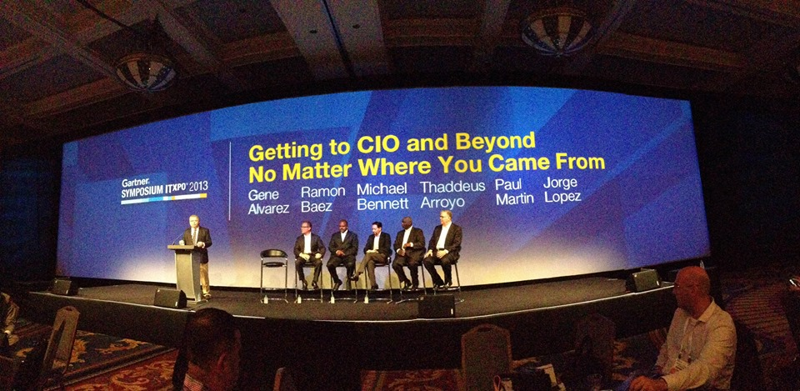
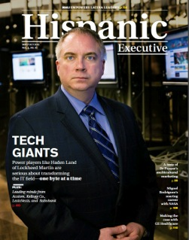
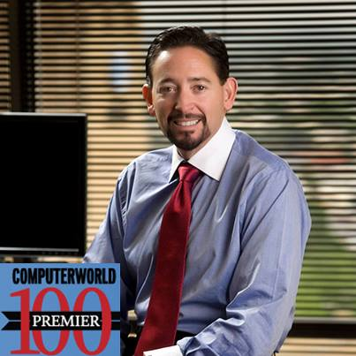
What does HITEC do?
“Push up, Pull up”
Push up strategy of raising the profiles of our top members and sponsors
Profiling in magazines, newspapers, and social media.
Speaking opportunities –
-As a speaker or panelist at one of our quarterly summits,
-Gartner's Symposium and IT Expo;
-Member conferences –
Cisco's Live,
HP's Discover, and
Oracle's OpenWorld;

Slide 4
What does HITEC do?
HITEC Pipeline
Emerging Executive Program (EEP)
Where young leaders are paired with senior leaders during a 9-month interactive mentorship program. Candidates graduate at a ceremony during the Q4 summit
Proyecto Nosotros
A career advancement program that places the resumes of participating members on the radar of qualifying member companies
HITEC 100 Awards Gala
United States
(Silicon Valley)
HITEC 50
Awards Gala
Latin America
(Miami)
This program recognizes the top 100 Hispanic IT Leaders in the USA and the Member/Corporation of the Year
This program recognizes the top 50 Hispanic IT Leaders
that do business in Latin America, in the gateway city of Miami

Slide 5
HITEC 3.0 Connect & Promote
Global Expansion
Connecting the Hispanic IT Pipeline
Gathering & Leveraging Hispanic Influence

Slide 6
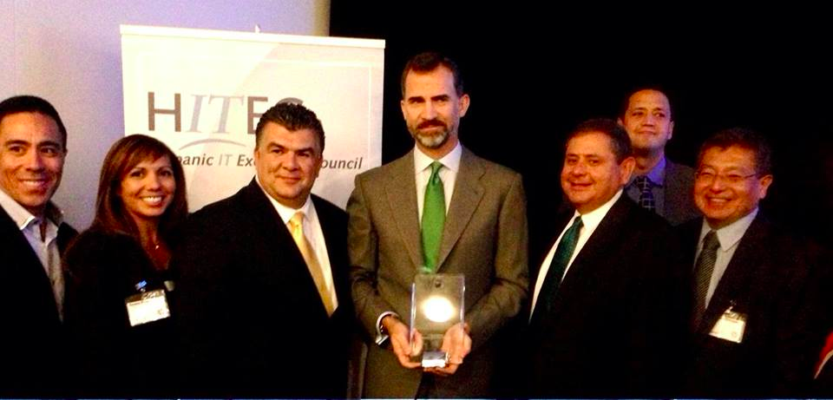
HITEC 3.0 Connect & Promote
1. Going Global

Slide 7
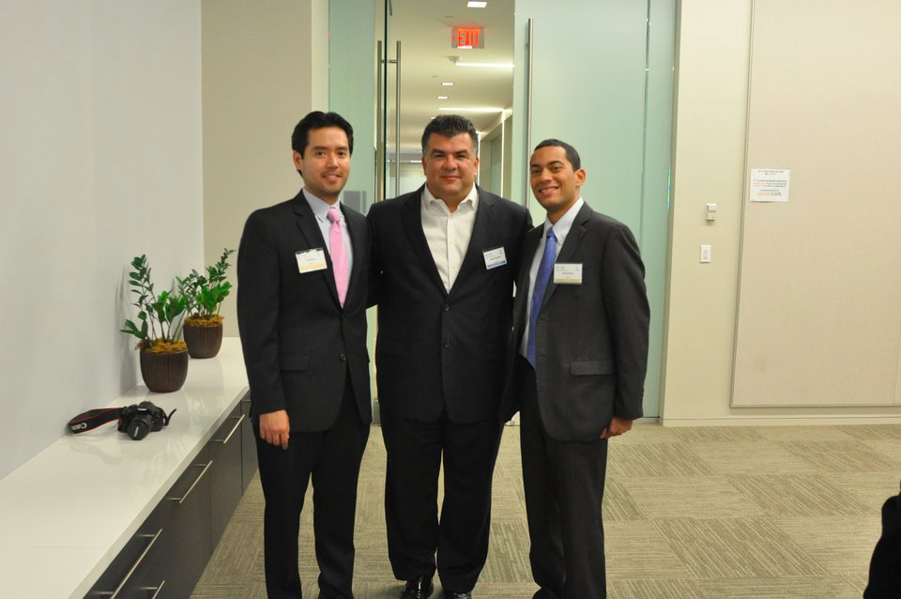
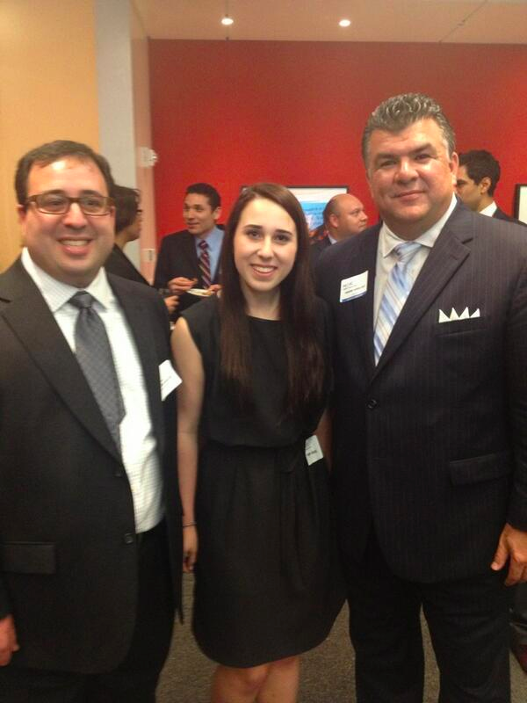
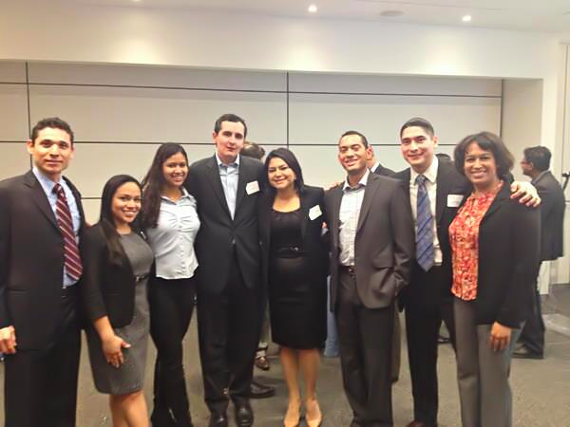
HITEC 3.0 Connect & Promote
2. Connecting the Hispanic IT Pipeline

Slide 8
HITEC 3.0 Connect & Promote
3. Gathering & Leveraging the Hispanic Influence
Immigration
CIO/CTO Positions
Tax Repatriation

Slide 9
Welcome to Miami

