Slide 1


Clinical & Translational Science Institutes
The U.S.A. launches an initiative to translate research findings into health outcomes
José Szapocznik, Ph.D.
Professor & Chair,
Department of Public Health Sciences
Director, Miami Clinical & Translational Science Institute
www.MiamiCTSI.org
Culturalized Health Sciences for a Healthier South Florida!

Slide 2
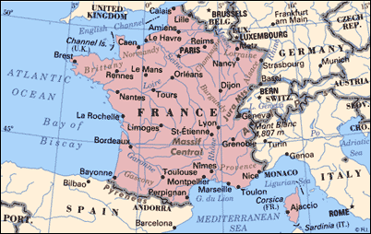

$2.7 Trillion

Slide 3
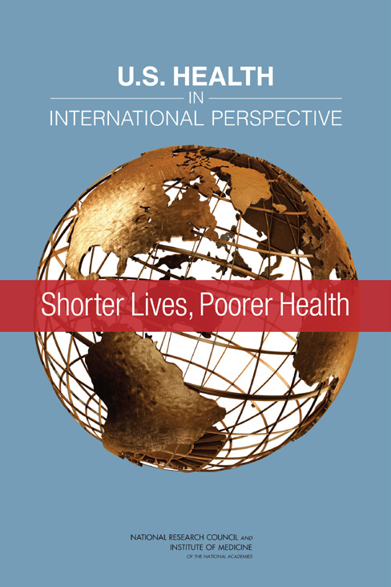

Slide 4
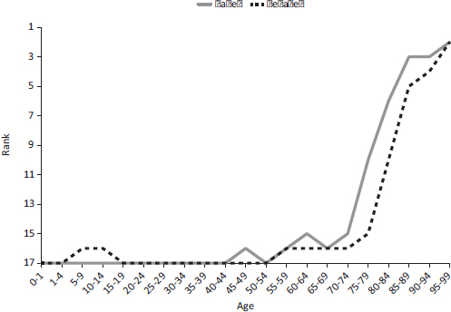
Males
Females
FIGURE 1-9 Ranking of U.S. mortality rates, by age group, among 17 peer countries,
2006-2008.

Slide 5
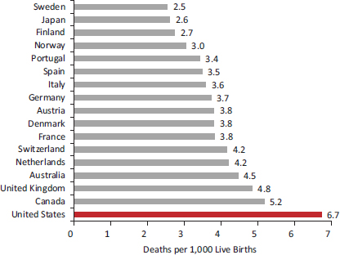
FIGURE 2-1 Infant mortality rates in 17 peer countries, 2005-2009.

Slide 6
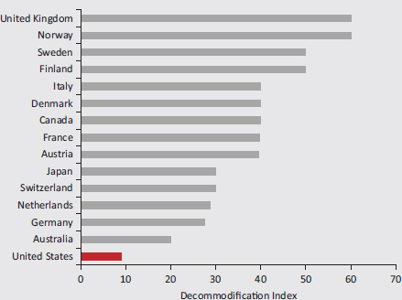
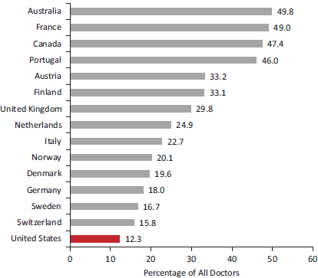
FIGURE 4-1a Access to health care independent of personal resources.
FIGURE 4-1 General practitioners as a proportion of total doctors in 15 peer countries, 2009.

Slide 7
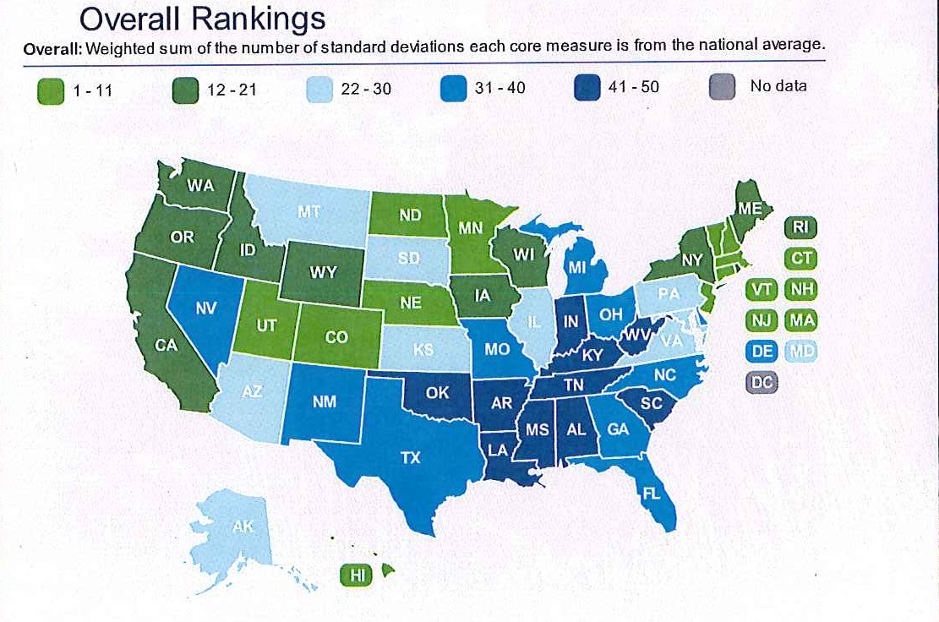

Slide 8
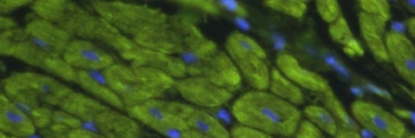
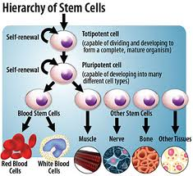
Stem Cell Therapy: The Healing Force of the Future
Regenerative medicine is a branch of translational research in Tissue Engineering and Molecular Biology which deals with the "process of replacing, engineering or regenerating human cells, tissues or organs to restore or establish normal function".^{[1]} This field holds the promise of engineering damaged tissues and organs via stimulating the body's own repair mechanisms to functionally heal previously irreparable tissues or organs.

Slide 9
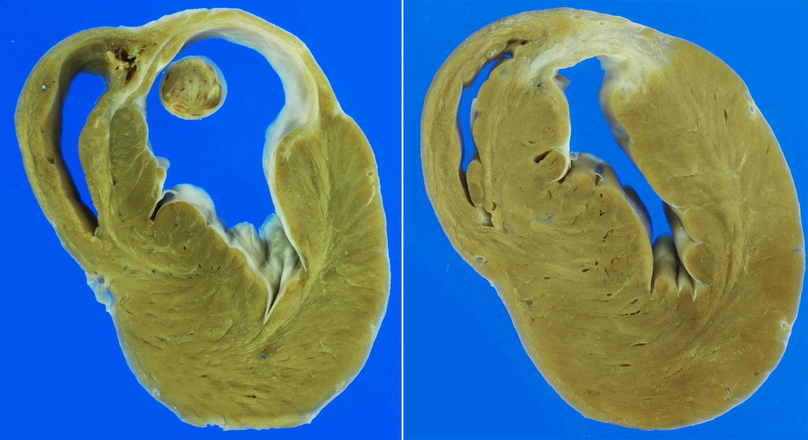
Mesenchimal Stem Cell (MSC) injection: Impact on reverse remodeling
Site of injection in the heart
Placebo 3-months after injection
MSC-treated 3-months after injection
Quevedo et al. PNAS 2009

Slide 10
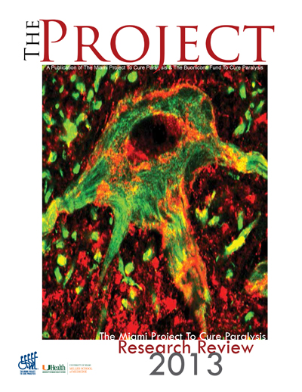
THE MIAMI PROJECT TO CURE PARALYSIS DOCTORS PERFORM FIRST SCHWANN CELL TRANSPLANT
Every 48 minutes someone in the US is paralyzed from a spinal cord injury

Slide 11


A 'Mini-Organ' Delivering Real Insulin in Real Time
a mini organ that mimics the native pancreas and restores the natural metabolic function of insulin release in immediate response to blood sugar levels

Slide 12

Clinical & Translational Science Awards
www.MiamiCTSI.org
National Institutes of Health –
Turning discovery into health
Miami CTSI--Culturalized Health Sciences for a Healthier South Florida!

Slide 13
Clinical & Translational Science Awards
www.MiamiCTSI.org
National scientific consortium to catalyze the development, testing and implementation of interventions that tangibly improve human health across a wide range of human diseases and conditions
Miami CTSI--Culturalized Health Sciences for a Healthier South Florida!

Slide 14
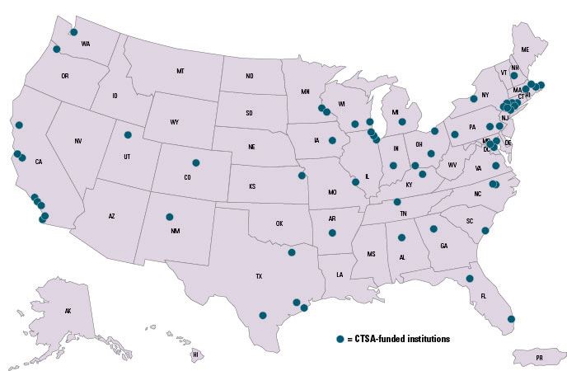
Clinical & Translational Science Awards
www.MiamiCTSI.org
“This consortium represents the first systematic change in our approach to clinical research in
50 years.”
Dr. Elias Zerhouni
NIH Director, 2006
Miami CTSI--Culturalized Health Sciences for a Healthier South Florida!

Slide 15
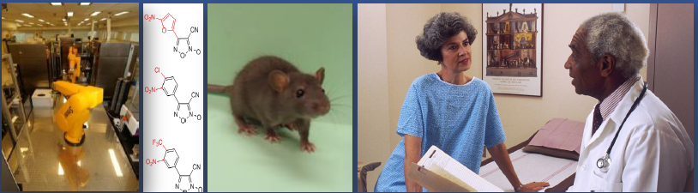
Mission
www.MiamiCTSI.org
Accelerate translation of scientific discoveries into prevention strategies and clinical treatments
Research partnerships to improve the health of our communities and the Nation
Miami CTSI--Culturalized Health Sciences for a Healthier South Florida!
Notes:
NCRP: where personnel can interact and receive training and mentorship.

Slide 16
Catalyzing Research Partnerships
www.MiamiCTSI.org
Miami CTSI--Culturalized Health Sciences for a Healthier South Florida!

Slide 17
Miami CTSI
www.MiamiCTSI.org
Culturally-competent treatments and prevention strategies need to be brought to the public more rapidly
  Driving scientific discovery is a team sport
  Collaborations across disciplines
  Integration across research platforms and health care
  Partnerships with diverse communities
  Important health discoveries need to be adopted in clinical practice, policy, and public health initiatives
Miami CTSI--Culturalized Health Sciences for a Healthier South Florida!

Slide 18
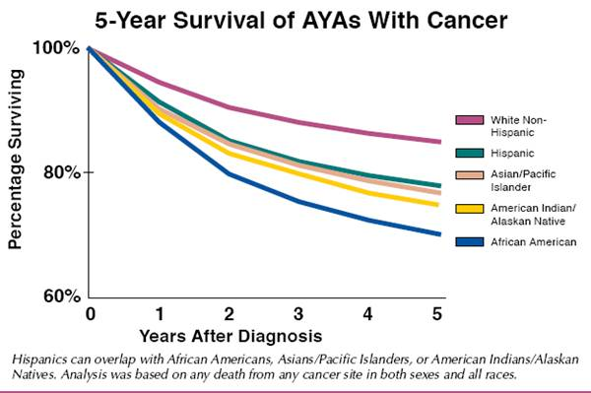


Slide 19
Thank you!

