Slide 1
VI HIGH-LEVEL SEMINAR: AT THE CURRENT GEOPOLITICAL CROSSROADS, IS THERE A ROLE FOR THE EUROPEAN UNION IN LATIN AMERICA? OCDE report: ASSESING THE Socio-economic impact of FDI in LAC A Focus on EU Investment
European Parliament – Brussels, February 23, 2026
Setsuko Saya Deputy Director, OECD Development Centre
Ana Novik Head of Investment, Directorate for Financial and Enterprise Affairs, OECD

Slide 2
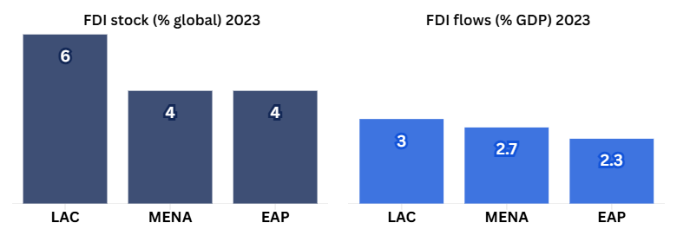
FDI is essential to closing LAC’s investment gap
LAC ~6% of global FDI stock
Inflows (~3% of GDP) are higher than in other developing regions
FDI remains structurally significant despite volatility in recent years
Sources: UNCTAD ​(2024)​, Foreign direct investment: Inward and outward flows and stock, annual and World Bank ​(2024)​, Foreign direct investment, net outflows (BoP, current US$)

Slide 3
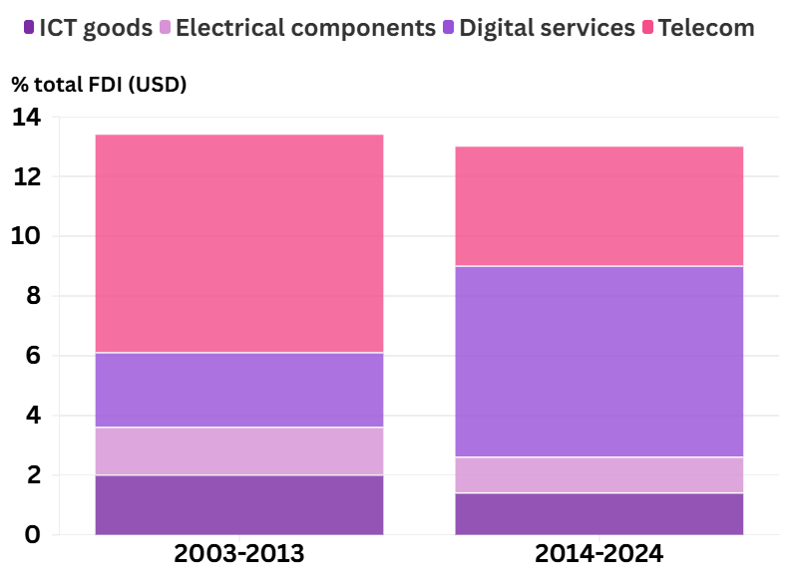
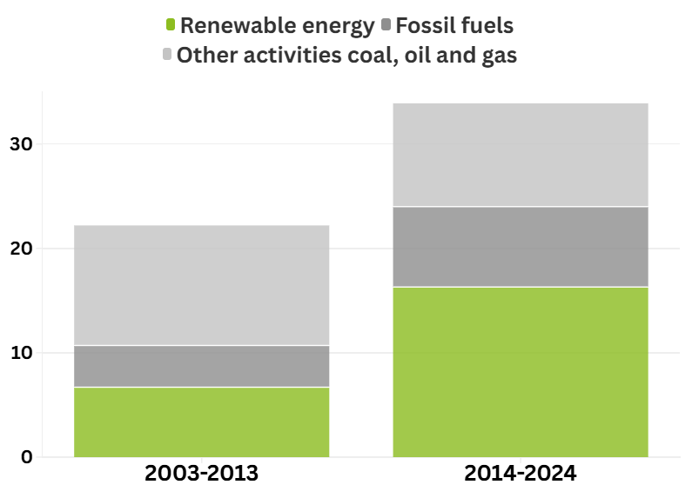
FDI has supported the twin transition in LAC
13% of FDI targeted digital sectors, with a shift from telecom to digital services
FDI in renewables have more than doubled, despite continued fossil-fuel investment
Sources: Financial Times ​(2025)​, FDI Markets (database)

Slide 4
Digital and renewables are boosting job creation
Digital sectors accounted for 20% of total jobs, driven by U.S. and EU job creation in digital services
Despite the low job-creation potential, jobs in renewable energy almost doubled to 3% of the total
% total FDI jobs
Sources: Financial Times ​(2025)​, FDI Markets (database)

Slide 5
EU invests in sectors that provide better jobs
Sectors receiving EU FDI compared to other sectors
Higher wages
Lower informality
More educated workforce
Wage ratio EU to non-EU sectors
Average informality rate
% workers with tertiary education
Sources: Financial Times ​(2025)​, FDI Markets (database), National Labour Force Surveys (latest available)

Slide 6





FDI has been a driver of structural transformation
FDI in TKI sectors
FDI targets low-value addition activities
EU FDI support export diversification
2003-2024
30%
EU
29.4%
GVCs
Solid basis for industrial upgrading
Opportunities in GVCs high-value activities remain untapped
A platform to support structural transformation
Sources: Financial Times ​(2025)​, FDI Markets (database), Eurostat, Technology classification of manufacturing industries, Technology and knowledge classification of services and WITS ​(2023)​, World Integrated Trade Solution (database)

Slide 7






Leveraging Trade and Investment for Development Impact in LAC: Opportunities and Challenges
Opportunities
Challenges
Low total investment – 19% of GDP
Renewable resources
Critical minerals
Skills development
GVCs integration
Technological / value chain upgrading
Skills mismatches
Low productivity growth – 0,9% yearly
Low tax revenue – 21% of GDP
Informality – 55% of workers
Climate vulnerability
Source: OECD et al. (2025), Latin American Economic Outlook 2025

Slide 8
Global challenges too……
Geopolitical changes: supply chain decision not guided by efficiency, but by strategic political considerations. Shift in budget (defence).
Increasing role of the State: ownership in some sectors AI/digital; tariffs and trade responses; industrial policies/subsidies.
Reconfiguration of globalisation (rather than deglobalisation)
Reduced business efforts to address global challenges, responding to the lack of policy signals.
Multilateral cooperation has become more difficult, and international standards are challenged.

Slide 9
What could be done? Enhancing the role of EU's trade and investment for increased impact
Trade and investment should be part of the solution, but:
Make globalisation to benefit all (link trade and investment policies with other “sustainable Policies”: OECD FDI Qualities initiative, EU Mercosur Agreement
Recognise the geopolitical changes and position the EU as a “trustworthy” partner in supply chain decisions: focus on long-term investment horizons and standards
Be aware that the introduction of trade and investment distortions has spillovers in partner countries (important to keep open mechanisms of discussions)
Encourage businesses to implement responsible business conduct standards
Within the reconfiguration of the global value chain:
The EU should deepen dialogue with LAC countries to enhance the socio-economic impact of investment and trade, identifying best practices and innovative approaches to guide an impact-focused EU–LAC agenda.
OECD could draw on its work to provide more evidence and work with countries and the private sector in peer learning dialogues, reinforcing Team Europe efforts.

Slide 10
Thank you! ¡Muchas gracias!

